Slide 1


State-space Search Agent for Programmable Matter
By Abbas Abdallah, Sleiman El Hajj, Tony Sleiman

Slide 2

Outline
1
Introduction
2
State-Space Definition
3
Project Evolution

Slide 3

Introduction

Slide 4
State-Space Definition
Shared State
Decoupled State
Overall arrangement of all pieces.
Individual state represented separately.
S = {(x₁, y₁), (x₂, y₂),., (xₙ, yₙ)}
Sᵢ = (xᵢ, yᵢ)
Centralized
Decentralized
Actions
Test Goals

Slide 5





Technologies

Slide 6
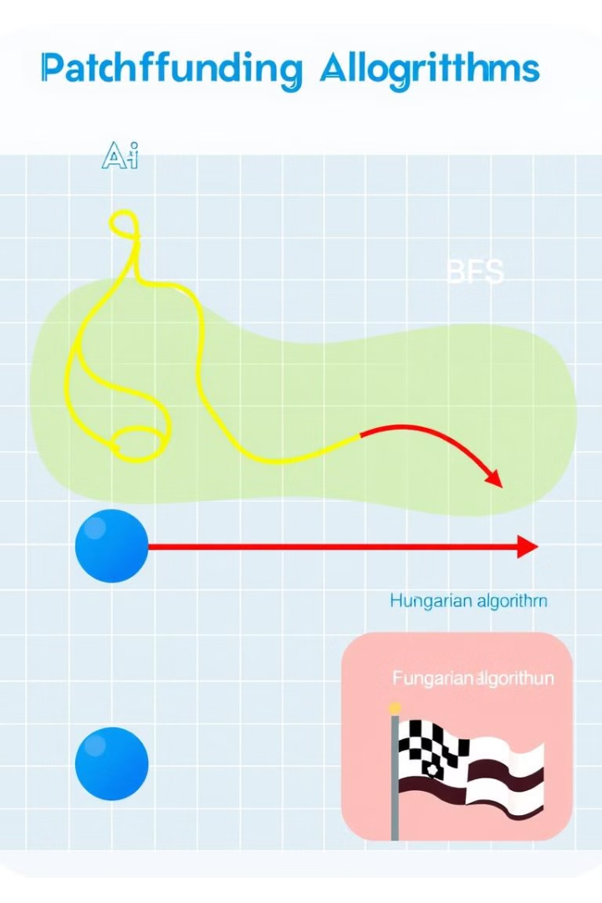


Algorithms Used
Assignment Algorithms:
Hungarian Algorithm
Traversal Algorithms
BFS, A*,

Slide 7
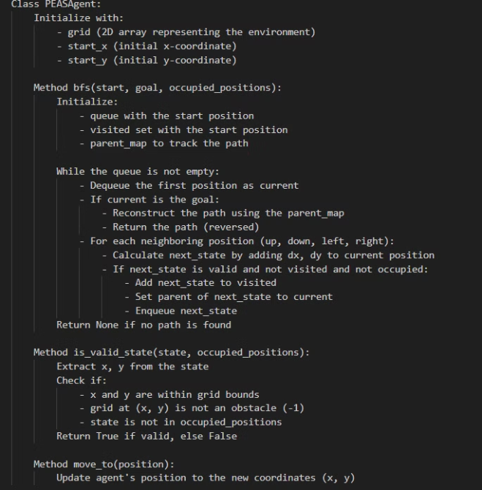

Evolution
One-by-one movement:

Slide 8
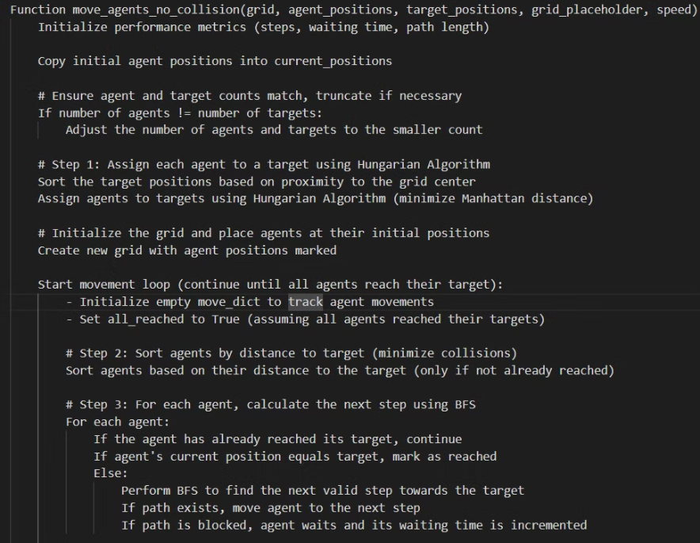
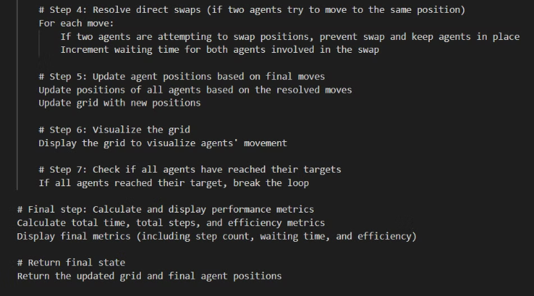
Von Neuman Topology

Slide 9
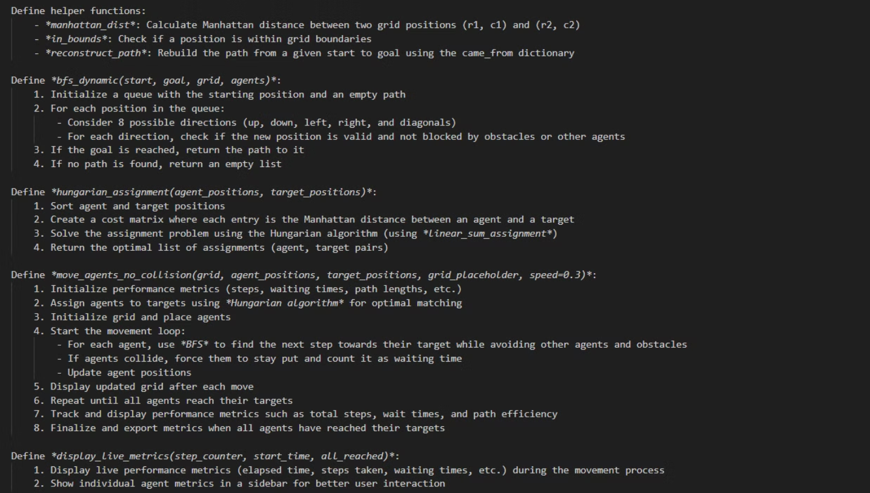
Diagonal Movement

Slide 10
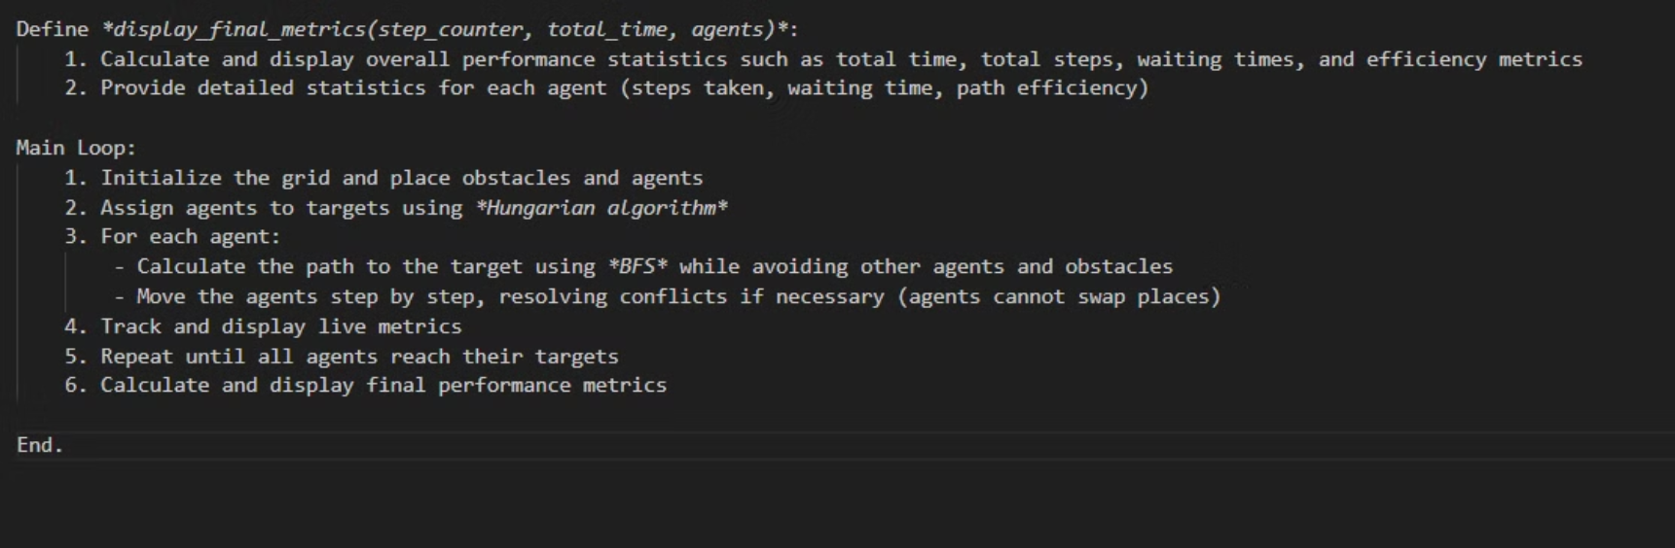

Slide 11
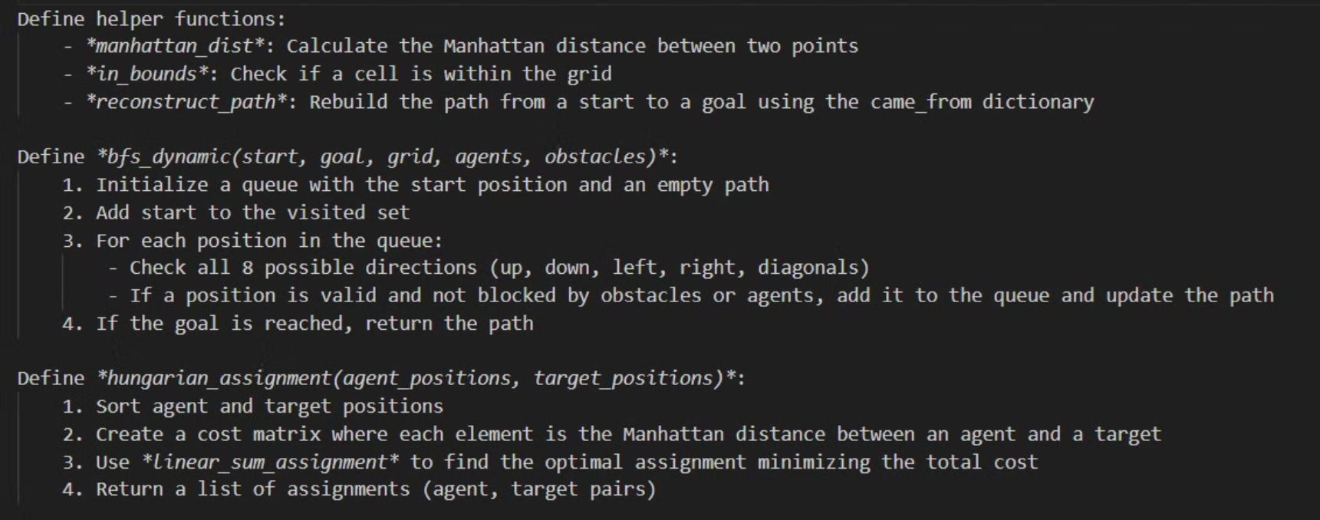
Obstacle Movement

Slide 12
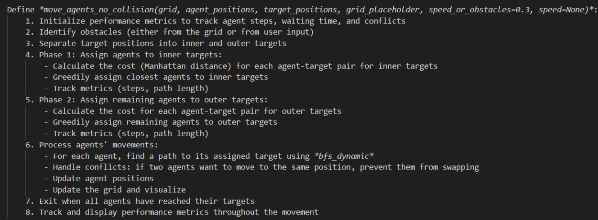

Slide 13
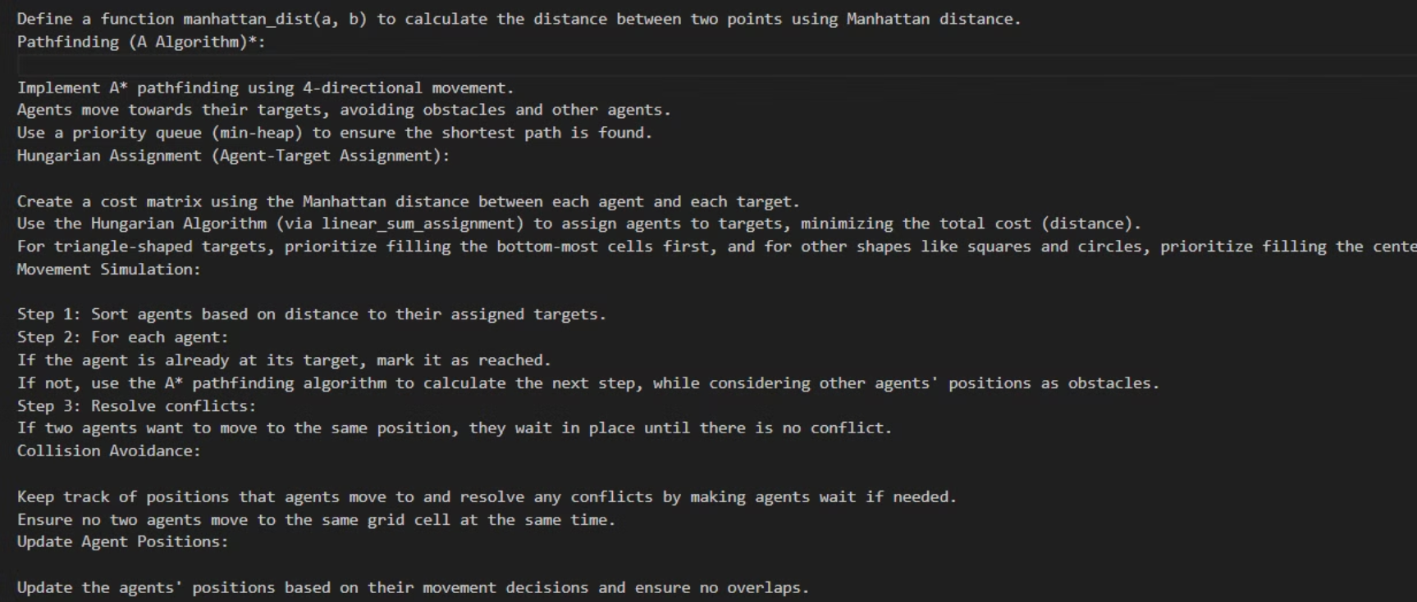
A*

Slide 14
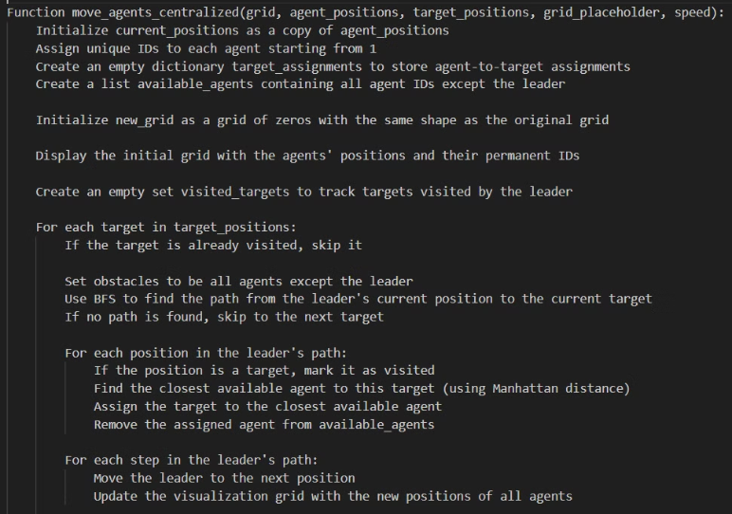
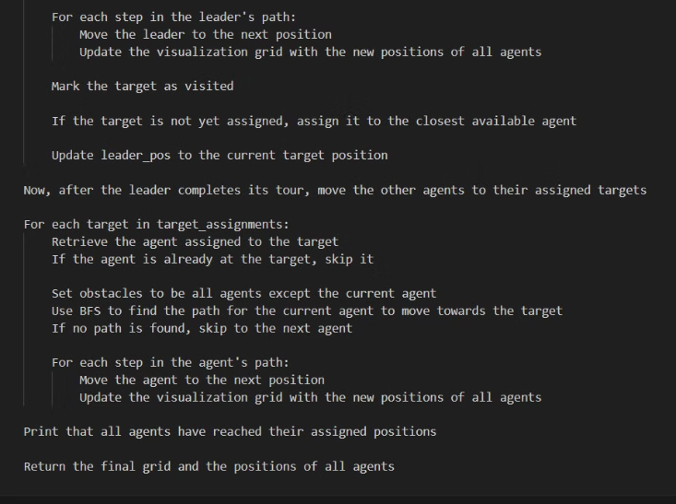
Centralized

Slide 15
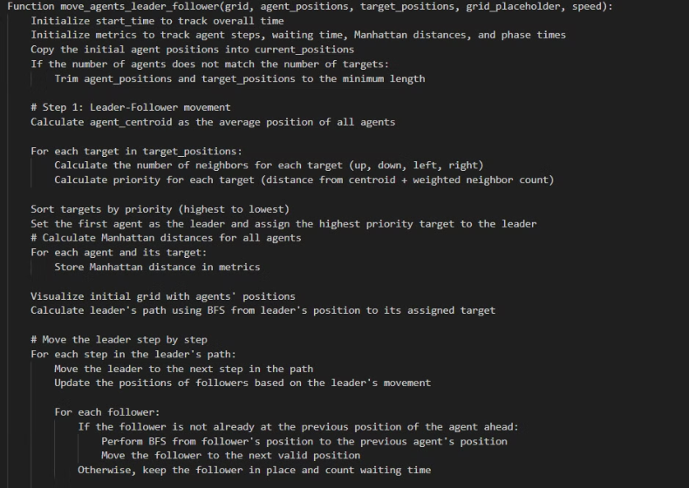
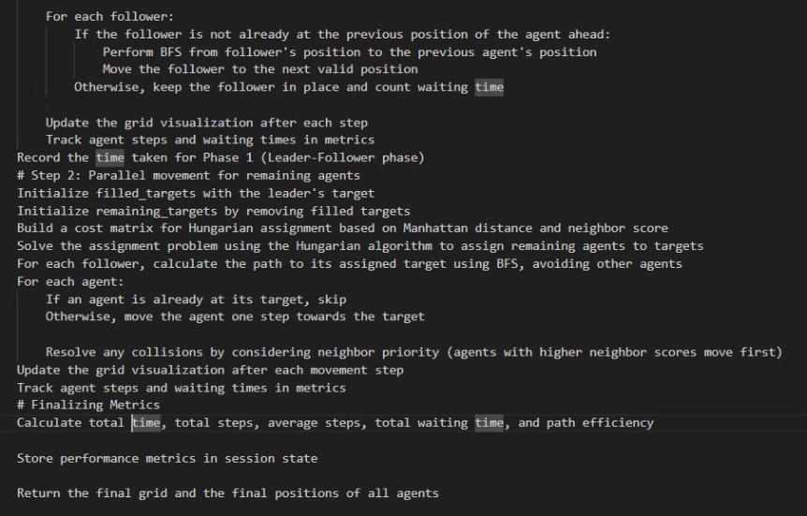
Leader-Follower

Slide 16

Conclusion & Future Work

